Slide 1
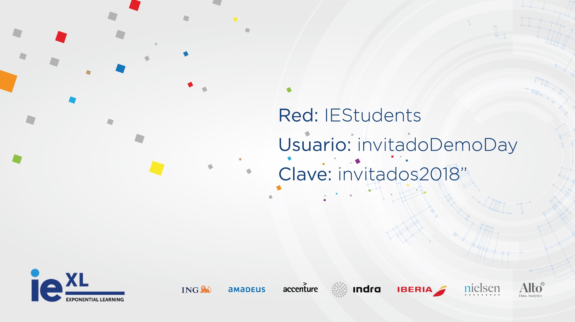


Slide 2
k means clustering
Notes:
‹#›

Slide 3
Notes:
‹#›

Slide 4
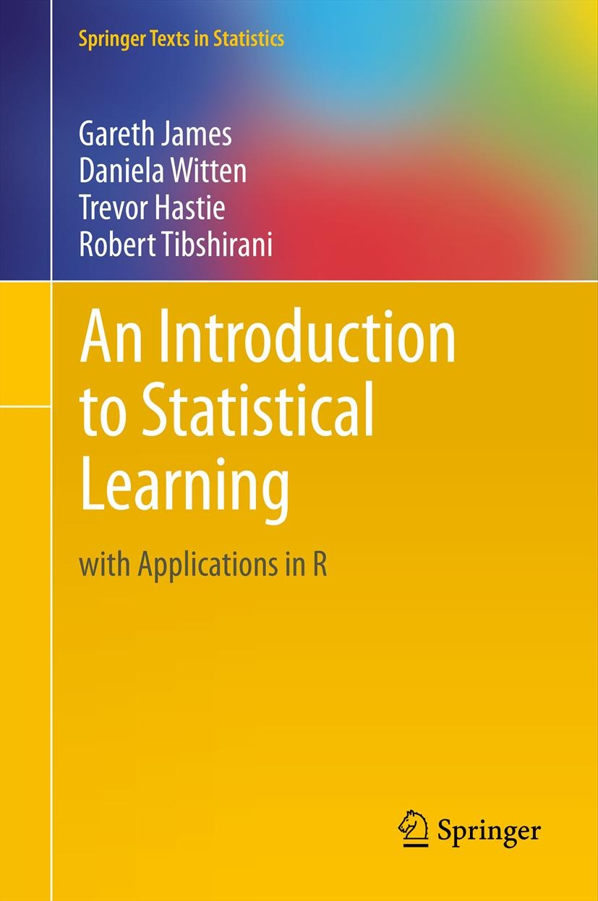
k means
references
Chapter 10
An Introduction to Statistical Learning
by Gareth James, et al.
https://www-bcf.usc.edu/~gareth/ISL/ISLR%20Seventh%20Printing.pdf
Notes:
‹#›

Slide 5
k means
theory
Unsupervised learning algorithm
It is one of the simplest way to solve a clustering problem
typical clustering problems:
cluster similar documents
custer customers
market segmentation
identify similar physical groups
Notes:
‹#›

Slide 6
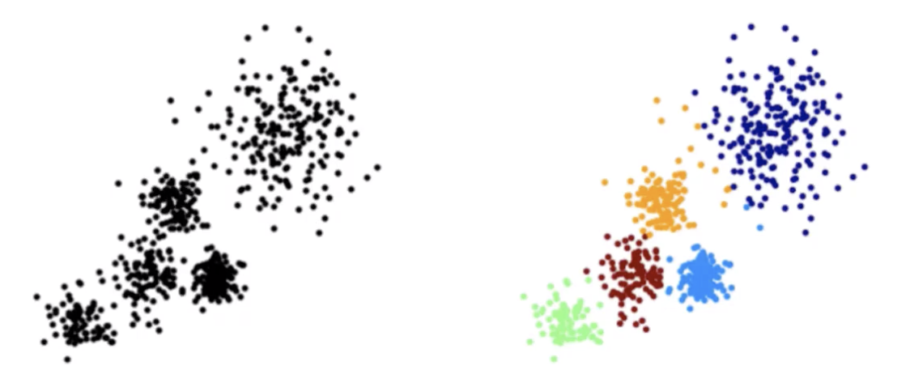
k means
theory
what is a cluster?
A cluster refers to a collection of data points aggregated together because of certain similarities.
Notes:
‹#›

Slide 7
k means
theory
what is a cluster?
A cluster refers to a collection of data points aggregated together because of certain similarities.
Notes:
‹#›

Slide 8
k means
theory
The objective of K-means is simple: group similar data points together and discover underlying patterns. To achieve this objective, K-means looks for a fixed number (k) of clusters in a dataset.
Notes:
‹#›

Slide 9
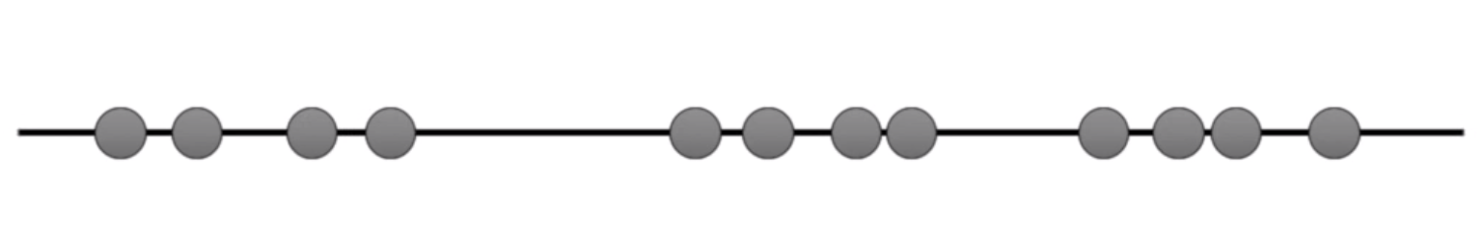
k means
easy
Imagine you have some data you can plot in a line
You already know the data is grouped in 3 clusters
Notes:
‹#›

Slide 10
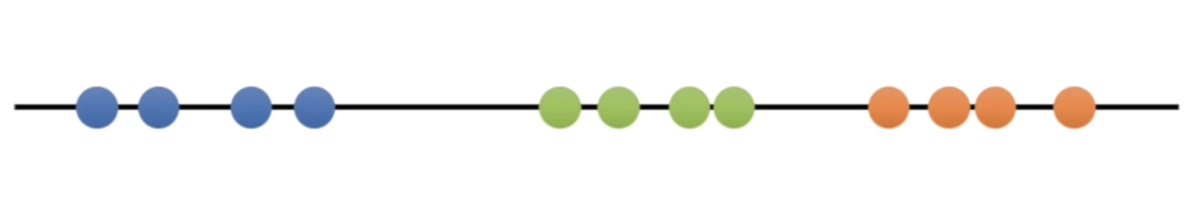
k means
easy
Imagine you have some data you can plot in a line
You already know the data is grouped in 3 clusters
In this case, the clusters are easy to see
Notes:
‹#›

Slide 11
k means
easy
0. Let’s start with the raw data
Notes:
‹#›

Slide 12
k means
easy
1. Select the number of clusters you want to identify.
This is the “K” in K-Means clustering
Let’s select k = 3
Notes:
‹#›

Slide 13
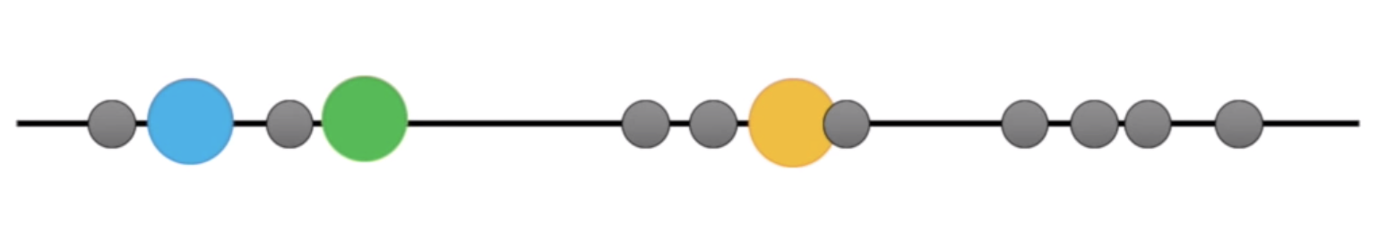
k means
easy
2. Randomly select 3 distinct data points
These are the initial clusters centroids
Notes:
‹#›

Slide 14
k means
easy
3. Measure the distance between the first point and the three centroids
Notes:
‹#›

Slide 15
k means
easy
3. Measure the distance between the first point and the three centroids
Notes:
‹#›

Slide 16
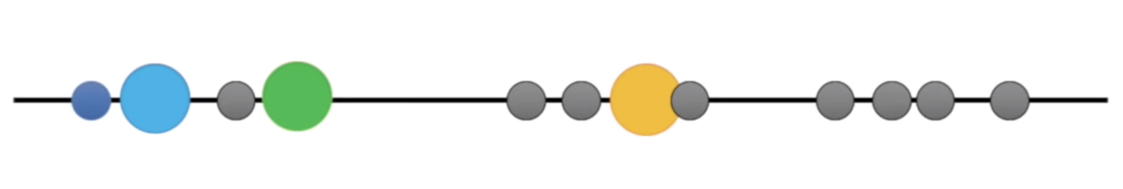
k means
easy
4. Assigns the point to the cluster to which the centroid is closest
Notes:
‹#›

Slide 17
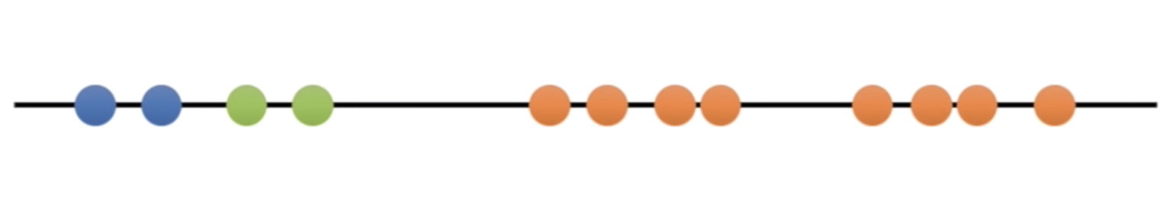
k means
easy
4. Assigns the point to the cluster to which the centroid is closest
Do the same thing for the rest of points
Notes:
‹#›

Slide 18
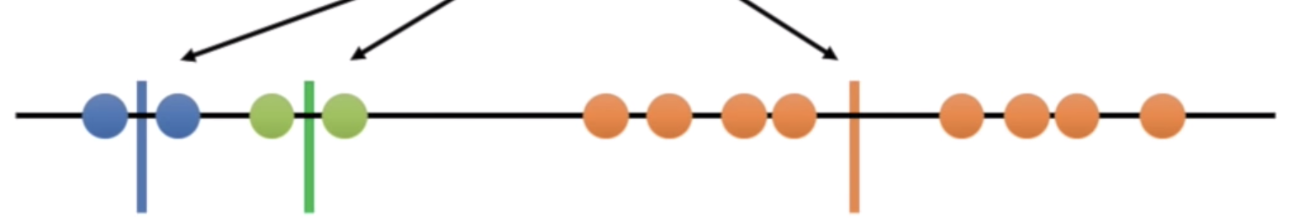
k means
easy
5. Calculate the mean of each cluster
Notes:
‹#›

Slide 19
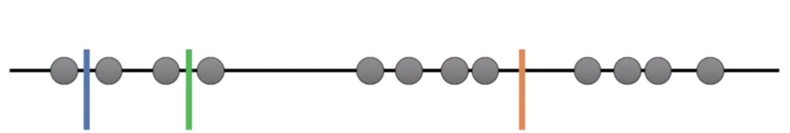
k means
easy
6. Repeat the process but using the mean instead of the centroids
Notes:
‹#›

Slide 20
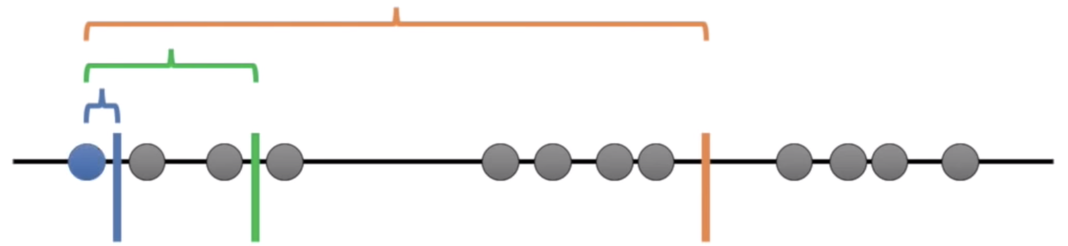
k means
easy
6. Repeat the process but using the mean instead of the centroids
Notes:
‹#›

Slide 21
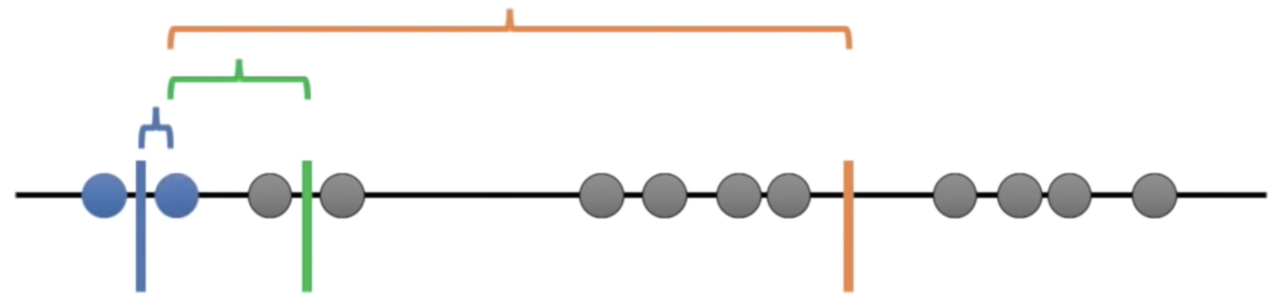
k means
easy
6. Repeat the process but using the mean instead of the centroids
Notes:
‹#›

Slide 22
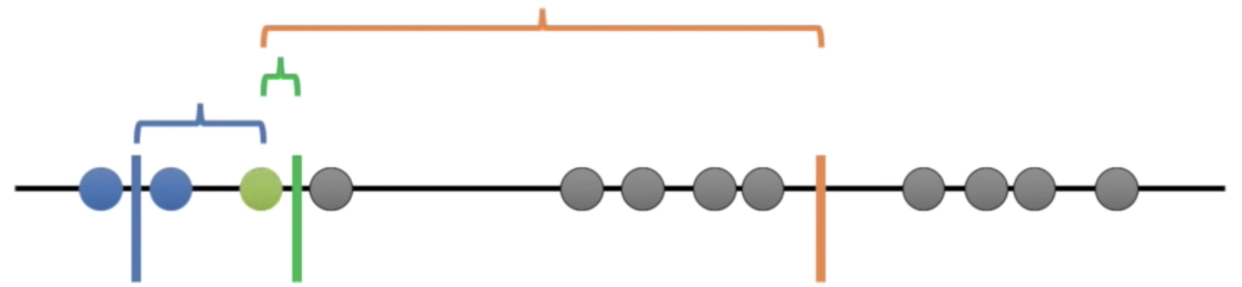
k means
easy
6. Repeat the process but using the mean instead of the centroids
Notes:
‹#›

Slide 23
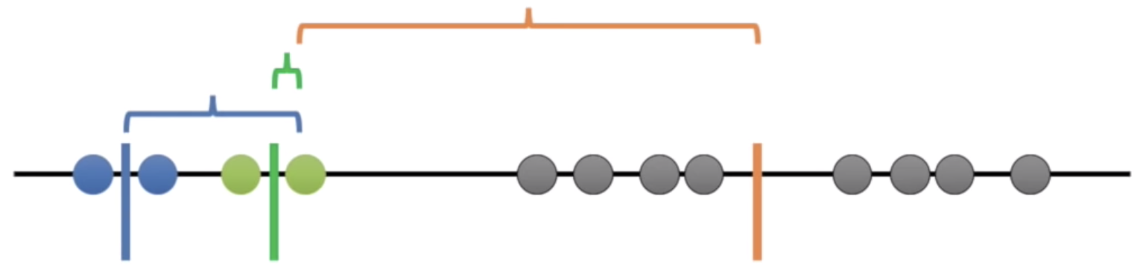
k means
easy
6. Repeat the process but using the mean instead of the centroids
Notes:
‹#›

Slide 24
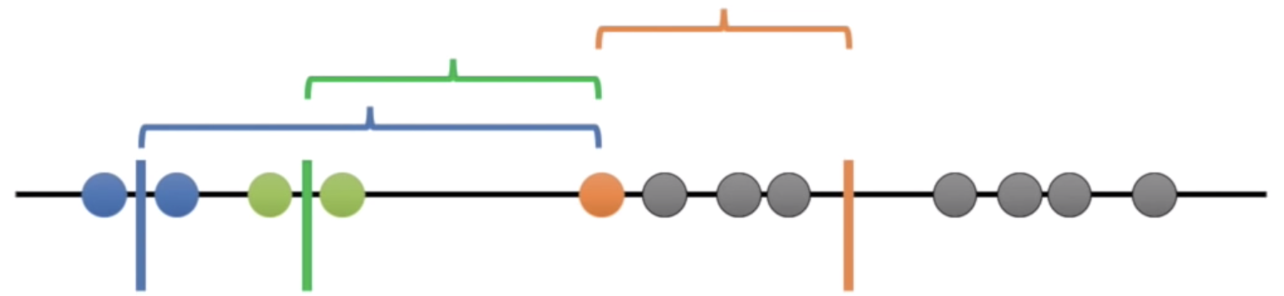
k means
easy
6. Repeat the process but using the mean instead of the centroids
Notes:
‹#›

Slide 25
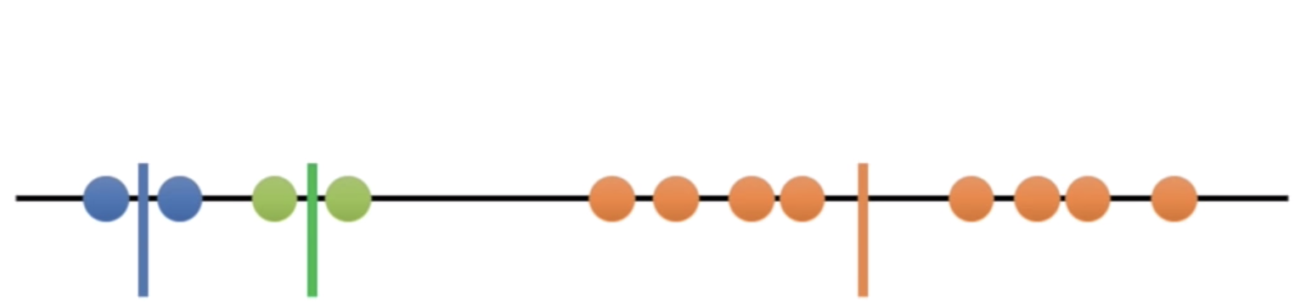
k means
easy
6. Repeat the process but using the mean instead of the centroids
Notes:
‹#›

Slide 26
k means
easy
But this is not what we expected to have!
Notes:
‹#›

Slide 27
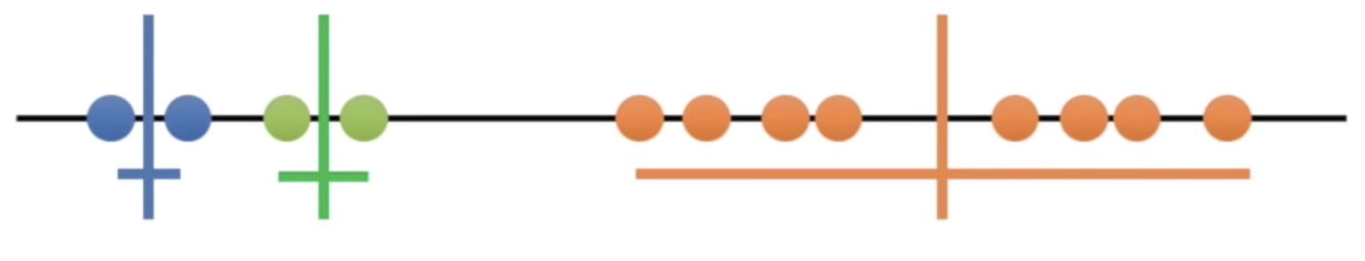
k means
easy
7. Add the variation within cluster
Notes:
‹#›

Slide 28
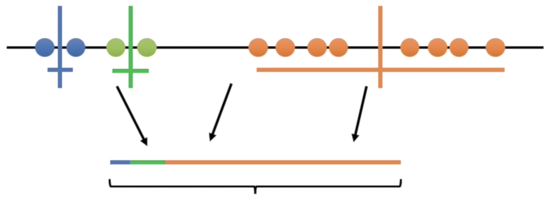
k means
easy
7. Add the variation within cluster
Total variation
Notes:
‹#›

Slide 29
k means
easy
7. Add the variation within cluster
Total variation
Notes:
‹#›

Slide 30
k means
easy
7. Add the variation within cluster
The goal now is to minimize the total variation. How?? -> Iterate
Total variation
Notes:
‹#›

Slide 31
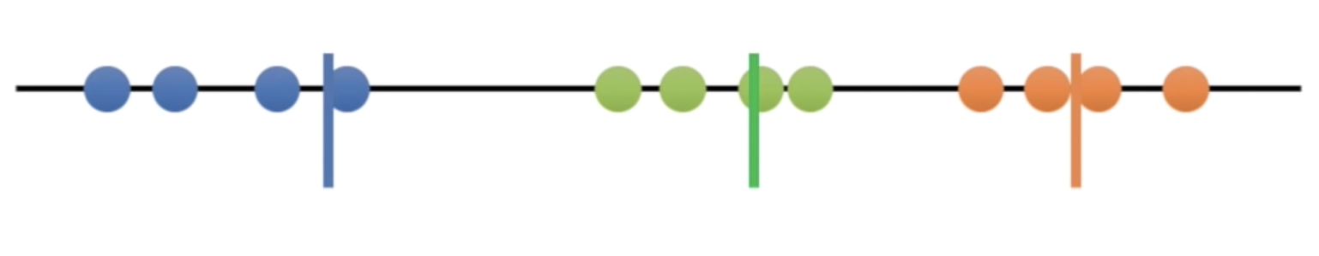
k means
easy
We have finally reach the cluster that minimize the total variation
Notes:
‹#›

Slide 32
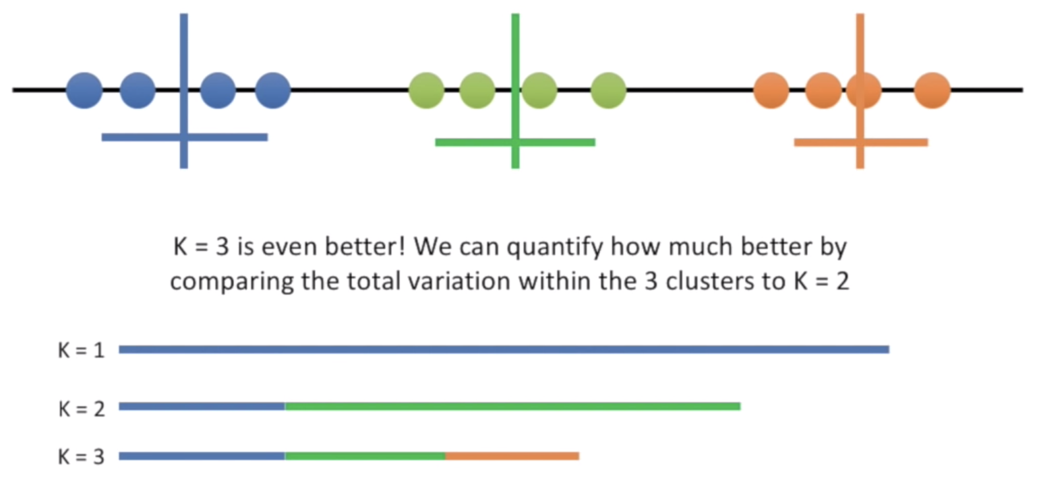
k means
easy
What is the best K? The one that minimize the variation
Notes:
‹#›

Slide 33
k means
easy
What is the best K? The one that minimize the variation
Notes:
‹#›

Slide 34
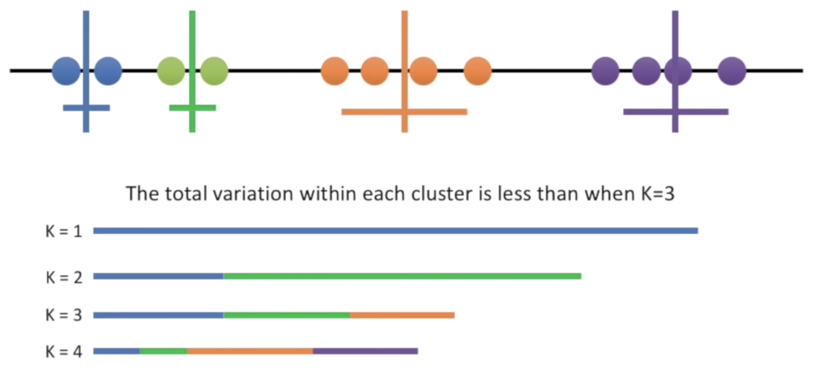
k means
easy
What if we try k = 4?
Notes:
‹#›

Slide 35
k means
easy
Each time we add a cluster (increases k by 1) the total variation is smaller.
So the best solution is when there is only one cluster per data point, innit??
If K=N then the variation is 0
Notes:
‹#›

Slide 36
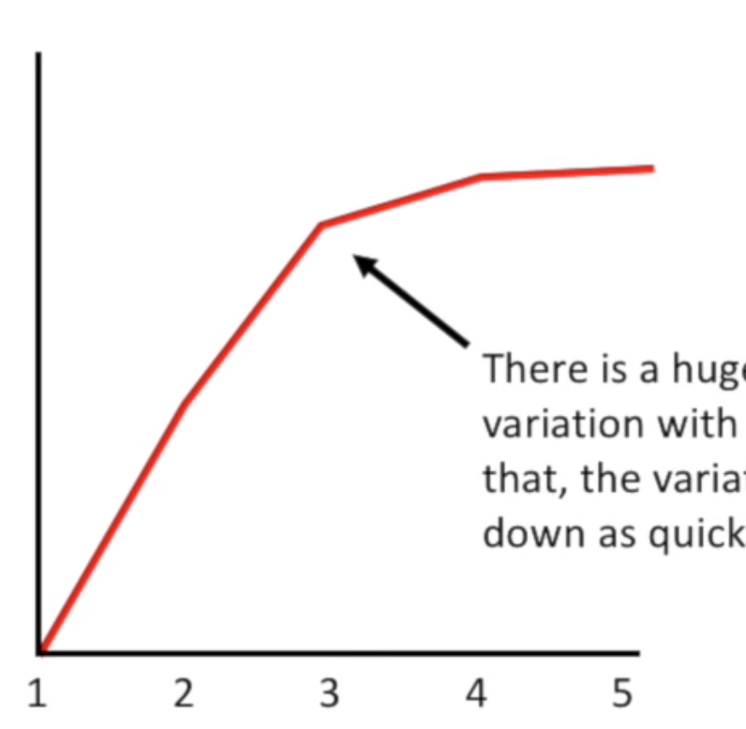
k means
easy
Solution : The elbow method
Total variation
k
Notes:
‹#›

Slide 37
k means
easy
Solution : The elbow method
Total variation
k
Notes:
‹#›

Slide 38
k means
theory
The objective of K-means is simple: group similar data points together and discover underlying patterns. To achieve this objective, K-means looks for a fixed number (k) of clusters in a dataset.
Notes:
‹#›

Slide 39
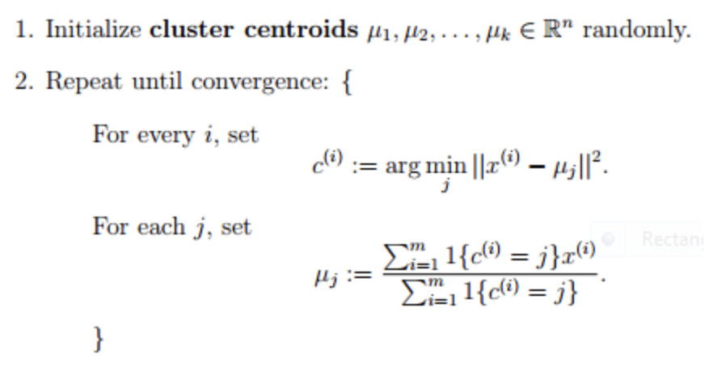
k means
pseudocode
Notes:
‹#›

Slide 40
k means
pseudocode
you choose a number of clusters K
kmeans randomly create K centroids (which are the imaginary data point that represent the cluster) and assign each data point to the cluster which centroid is closest
Until convergence repeat:
for each cluster, compute the cluster centroid by taking the mean vector of data points in the cluster
assign each data point to the cluster for which the centroid is the closest.
Notes:
‹#›

Slide 41
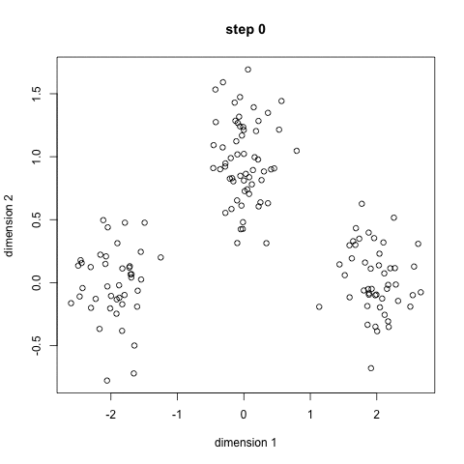
k means
pseudocode
Notes:
‹#›

Slide 42
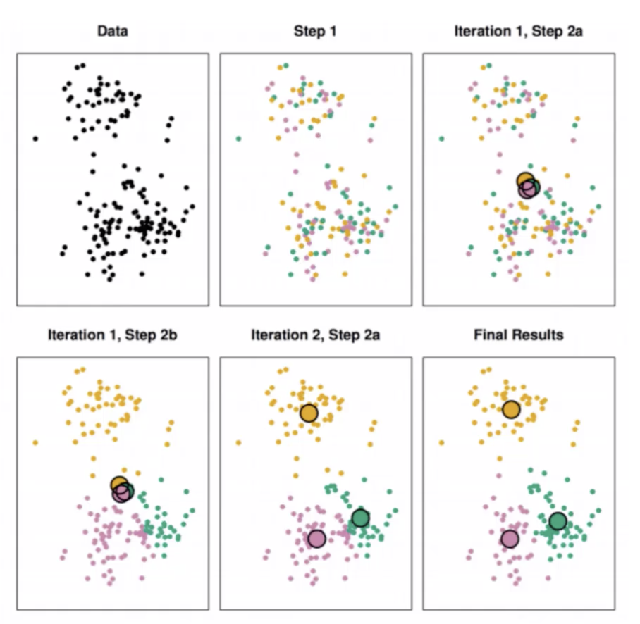
k means
pseudocode
Notes:
‹#›

Slide 43
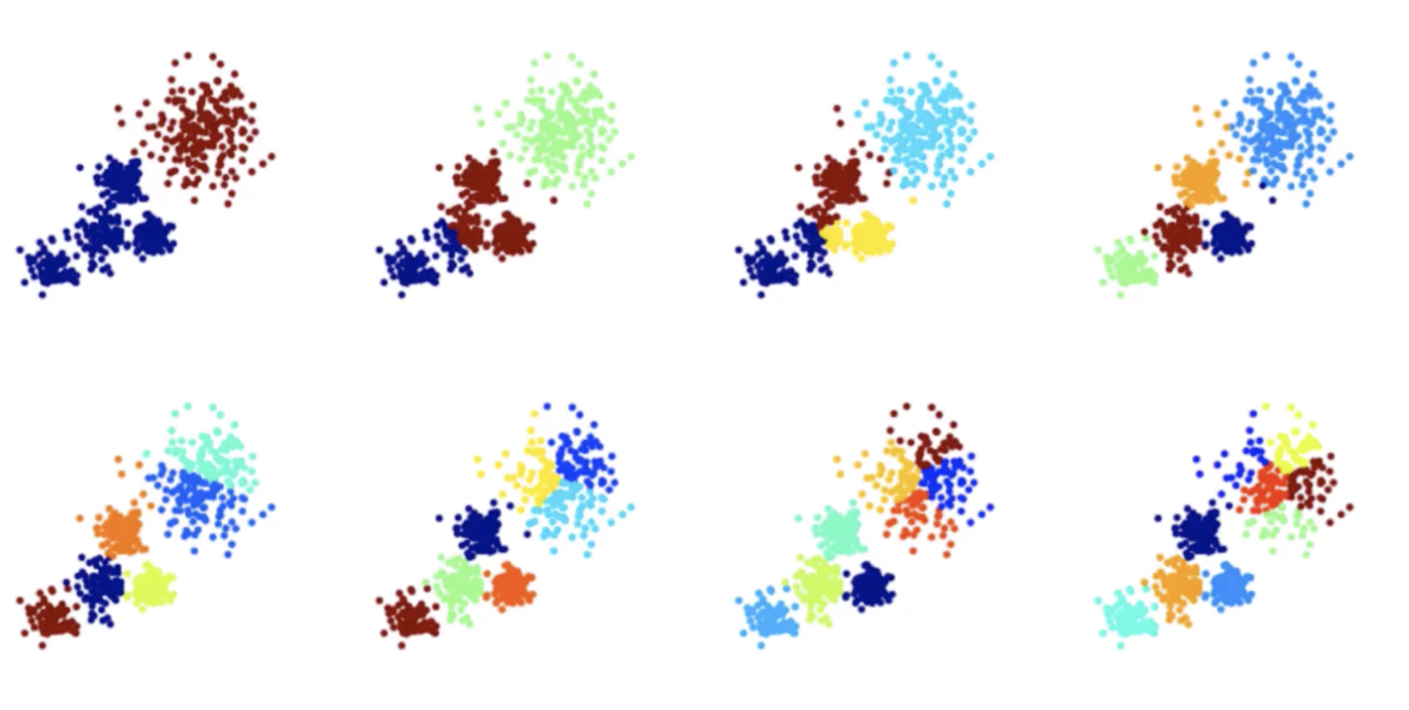
k means
choosing a k value
Notes:
‹#›

Slide 44
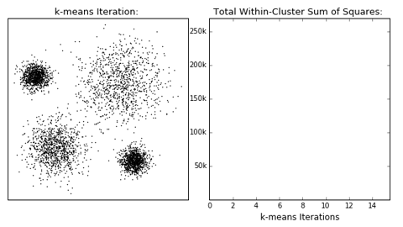
k means
choosing a k value
Notes:
‹#›

Slide 45
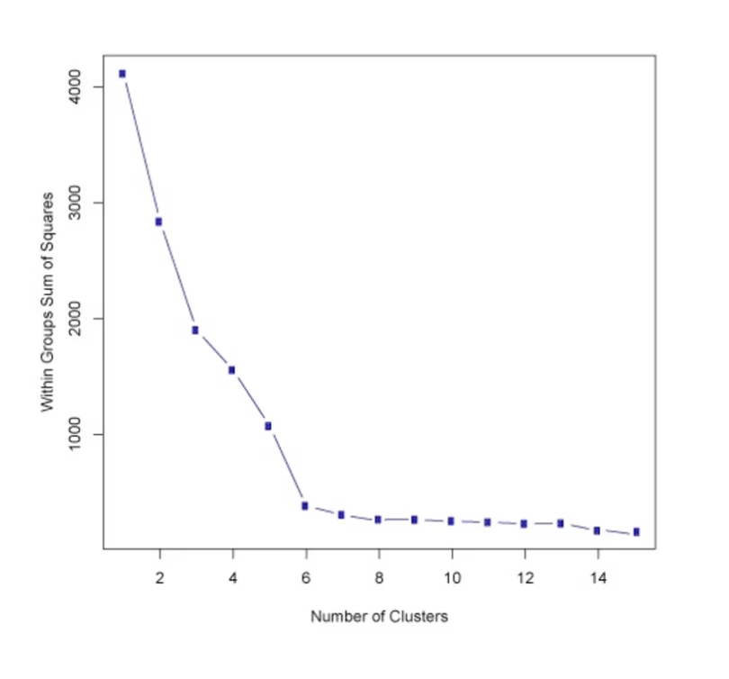
k means
choosing a k value
Notes:
‹#›

Slide 46
k means
choosing a k value
Notes:
‹#›

Slide 47
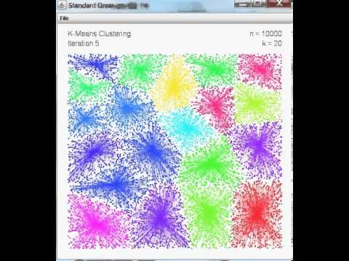
k means
visual
Notes:
‹#›

Slide 48

k means
scratch
Notes:
‹#›

Slide 49


